Slide 1
Thread
Java is a multi-threaded programming language. A multi-threaded program contains two or more parts that can run concurrently and each part can handle a different task at the same time making optimal use of the available resources specially when the computer has multiple CPUs.
By definition, multitasking is when multiple processes share common processing resources such as a CPU.
Multi-threading extends the idea of multitasking into applications where you can subdivide specific operations within a single application into individual threads. Each of the threads can run in parallel.
Multi-threading enables you to write in a way where multiple activities can proceed concurrently in the same program

Slide 2
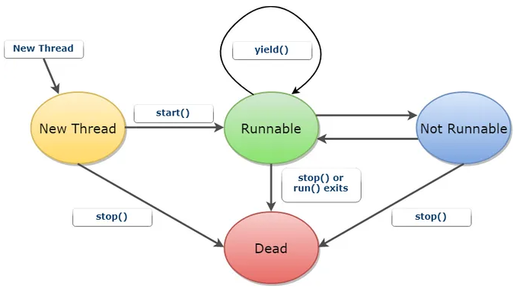
Thread – Life Cycle
A thread goes through various stages in its life cycle. For example, a thread is born, started, runs, and then dies. The following diagram shows the complete life cycle of a thread.

Slide 3
Thread – Stages
New Thread: A new thread begins its life cycle in the new state. The process remains in this condition until the program starts the thread.
Runnable: As soon as the new thread starts, the thread status becomes Runnable. At this stage, a thread is considered to execute its function or working.
Not Runnable: A Runnable thread when entered the time of waiting for the state for a specific interval of time. That time, the thread is not in Runnable condition.
Waiting: Sometimes, a thread transitions to the waiting state while the thread waits for another thread to perform a task. A thread transitions back to the runnable state only when another thread signals the waiting thread to continue executing.
Dead / Terminated: The Runnable thread enters the end stage when it completes its tasks.

Slide 4
Thread - Priorities
Every Java thread has a priority that helps the operating system determine the order in which threads are scheduled.
Java thread priorities are in the range between MIN_PRIORITY (a constant of 1 ) and MAX_PRIORITY (a constant of 10). By default, every thread is given priority NORM_PRIORITY (a constant of 5).
Threads with higher priority are more important to a program and should be allocated processor time before lower-priority threads

Slide 5
Thread – Creation
One of the way to create a thread is to create a new class that extends Thread class using the following two simple steps. This approach provides more flexibility in handling multiple threads created using available methods in Thread class.
Step 1:
Once Thread object is created, you can start it by calling start( ) method, which executes a call to run( ) method. Syntax of start() method:
void start( )
Step 2:
You will need to override run( ) method available in Thread class. This method provides an entry point for the thread and you will put your complete business logic inside this method. syntax of run() method:
public void run( )

Slide 6
Thread Class Constructors
Commonly used Constructors of Thread class:
Thread()
Thread(String name)
Thread(Runnable r)
Thread(Runnable r,String name)

Slide 7
Runnable and Thread classes
Thread can be created by extending the Thread class and overriding its run() method:
public class Main extends Thread {
public void run() {
System.out.println("This code is running in a thread");
}
}
Another way to create a thread is to implement the Runnable interface:
public class Main implements Runnable {
public void run() {
System.out.println("This code is running in a thread");
}
}

Slide 8
Thread – Runnable Interface
The otherway to create thread is runnable interface . If we extend the Thread class, our class cannot extend any other class because Java doesn’t support multiple inheritance. But, if we implement the Runnable interface, our class can still extend other base classes.
We can achieve basic functionality of a thread by extending Thread class because it provides some inbuilt methods like yield(), interrupt() etc. that are not available in Runnable interface.
Using runnable will give you an object that can be shared amongst multiple threads.

Slide 9
Thread – Creations
public class Main extends Thread {
public static void main(String[] args) {
Main ob1 = new Main();
ob1.start();
System.out.println(“Outside of the thread");
}
public void run() {
System.out.println(“Running in a thread");
} }
Thread can be created by extending
public class Main implements Runnable {
public static void main(String[] args) {
Main obj = new Main();
Thread ob1= new Thread(obj);
ob1.start();
System.out.println(“Outside of the thread");
}
public void run() {
System.out.println(“Running in a thread");
} }
Thread can be created by implements

Slide 10
Thread - Methods
Method | Description
public void start() | Starts the thread in a separate path of execution, then invokes the run() method on this Thread object.
public void run() | If this Thread object was instantiated using a separate Runnable target, the run() method is invoked on that Runnable object.
public final void setName (String name) | Changes the name of the Thread object. There is also a getName() method for retrieving the name.
public final void setPriority (int priority) | Sets the priority of this Thread object. The possible values are between 1 and 10.
public Thread currentThread() | returns the reference of currently executing thread.

Slide 11
Thread - Methods
Method | Description
public void notify() | It is used to give the notification for only one thread which is waiting for a particular object.
public void notifyAll() | It is used to give the notification to all waiting threads of a particular object
public final void join(long millisec) | The current thread invokes this method on a second thread, causing the current thread to block until the second thread terminates or the specified number of milliseconds passes
public final void join() | Current thread waits for another thread to finish.
public final boolean isAlive() | Returns true if the thread is alive, which is any time after the thread has been started but before it runs to completion.
public final void setDaemon (Boolean on) | A parameter of true denotes this Thread as a daemon thread.

Slide 12
Thread - Methods
Method | Description
public final void suspend() | This method is used to stop the thread execution and start it again when a certain event occurs. This method allows a thread to temporarily cease execution.
public final void resume() | It is used to resume the suspended thread.
public final void stop () | It is used to stop the thread.
public static void sleep(long millisec) | Causes the currently running thread to block for at least the specified number of milliseconds. This is static method
public void yield() | causes the currently executing thread object to temporarily pause and allow other threads to execute.

Slide 13
Thread – Concurrency Problems
Threads run at the same time as other parts of the program, there is no way to know in which order the code will run.
public class Main extends Thread {
public static int amount = 0;
public static void main(String[] args) {
Main ob1 = new Main();
// Wait for the thread to finish
ob1.start();
while(ob1.isAlive()) {
System.out.println("Waiting...");
}
// Update amount and print its value
System.out.println("Main: " + amount);
amount++;
System.out.println("Main: " + amount); }
public void run() {
amount++; } }
public class Main extends Thread {
public static int amount = 0;
public static void main(String[] args) {
Main ob1= new Main();
ob1.start();
System.out.println(amount);
amount++;
System.out.println(amount);
}
public void run() {
amount++;
}
}
Output:
WaitingMain: 1
Main: 2
Output:
0
1

Slide 14
Thread – Methods Classification
Make other threads to wait – isAlive(), join(), join(waiting time)
Inter Thread Communication – wait(), notify(), notifyAll() – throws InterruptedException and handle in synchronized methods
Deadlock Mechanism – suspend(), resume(), stop()

Slide 15
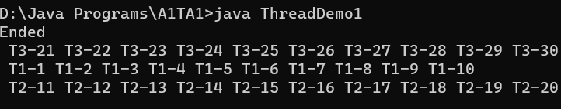
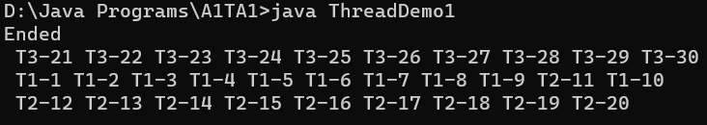
ThreadDemo1.java
// NON SYNCHRONIZED THREAD PROCESS
class ThreadModel1 extends Thread{
String name;
int min, max;
ThreadModel1(String name, int min, int max){
this.name = name; this.min = min;this.max = max; }
public void run(){
for(int i=min;i<=max;i++)
System.out.print(" "+name+"-"+i);
System.out.println(); }
}
public class ThreadDemo1{
public static void main(String []a){
ThreadModel1 o1 = new ThreadModel1("T1",1,10);
ThreadModel1 o2 = new ThreadModel1("T2",11,20);
ThreadModel1 o3 = new ThreadModel1("T3",21,30);
o1.start(); o2.start(); o3.start();
System.out.println("Ended"); } }
Execution-1
Execution-2

Slide 16
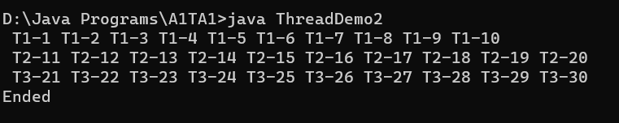
ThreadDemo2.java
// CONSTRUCTOR IS REMOVED - OVERRIDEN THE START METHOD TO SYNCHRONIZE
class ThreadModel2 extends Thread{
String name;
int min, max;
public void start(String name, int min, int max){
this.name = name; this.min = min;this.max = max;
this.run();
}
public void run(){
for(int i=min;i<=max;i++)
System.out.print(" "+name+"-"+i);
System.out.println();
}
}
public class ThreadDemo2{
public static void main(String []a){
ThreadModel2 o1 = new ThreadModel2();
ThreadModel2 o2 = new ThreadModel2();
ThreadModel2 o3 = new ThreadModel2();
o1.start("T1",1,10); o2.start("T2",11,20);
o3.start("T3",21,30);
System.out.println("Ended");
}
}
Execution-1

Slide 17
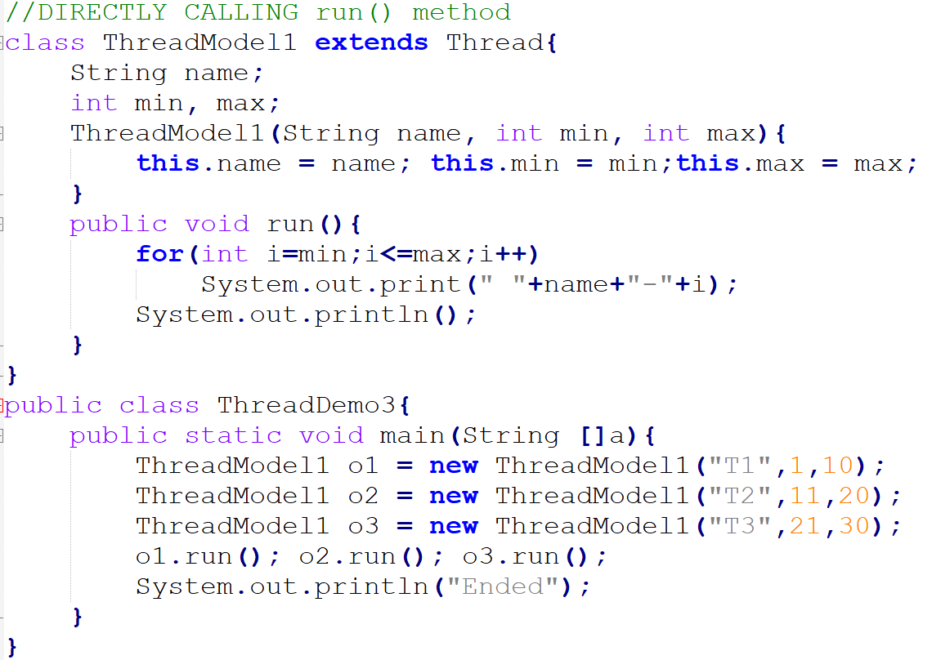
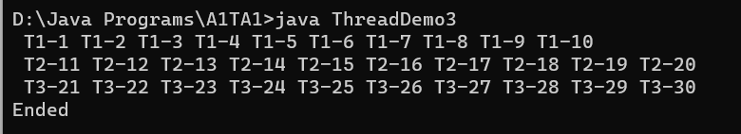
ThreadDemo3.java

Slide 18
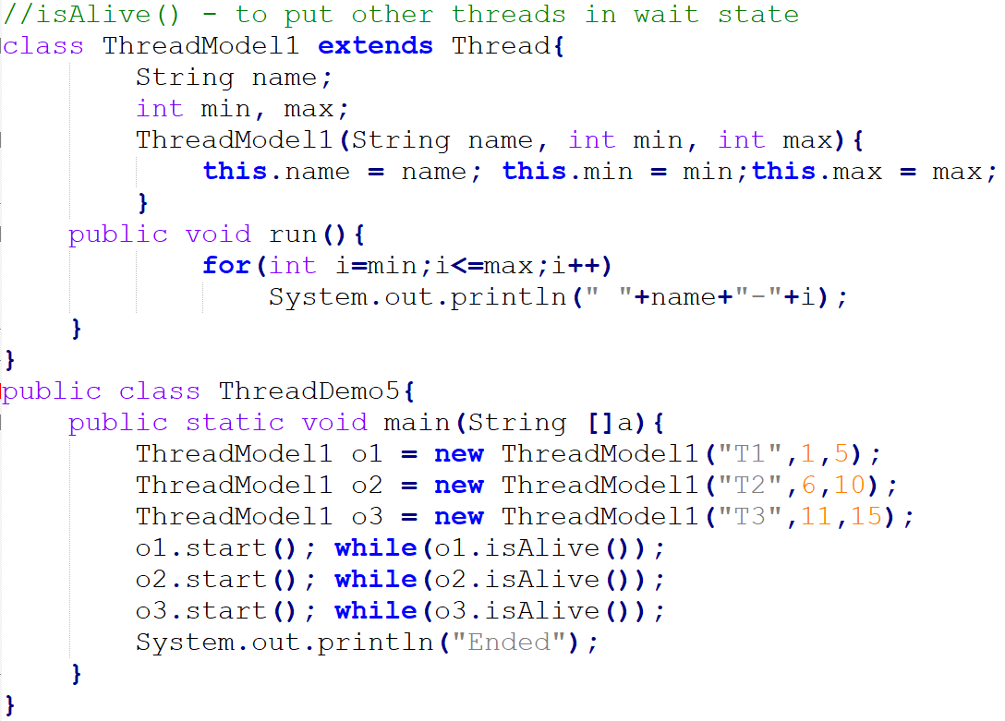
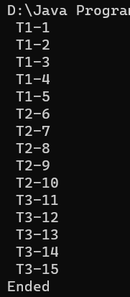
ThreadDemo5.java

Slide 19
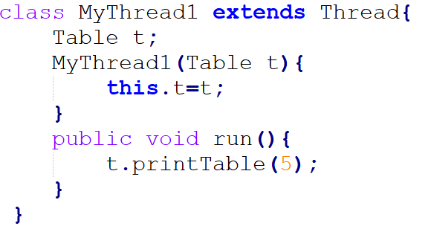
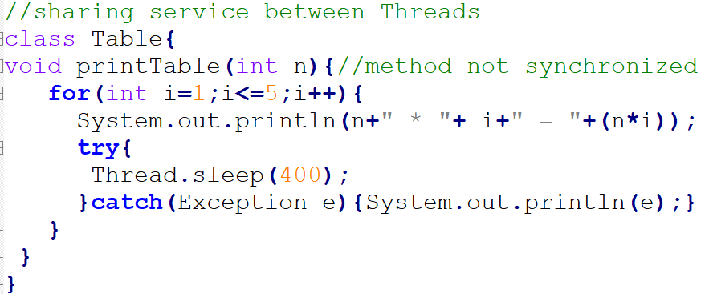
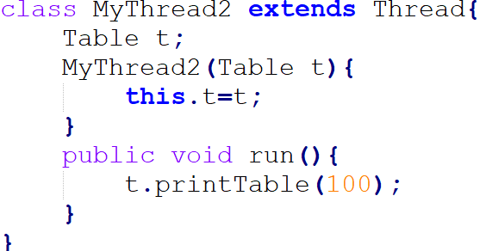
Inter Thread – Non Synchronized
CALLS TO PRINT 5TH TABLE
CALLS TO PRINT 100TH TABLE

Slide 20
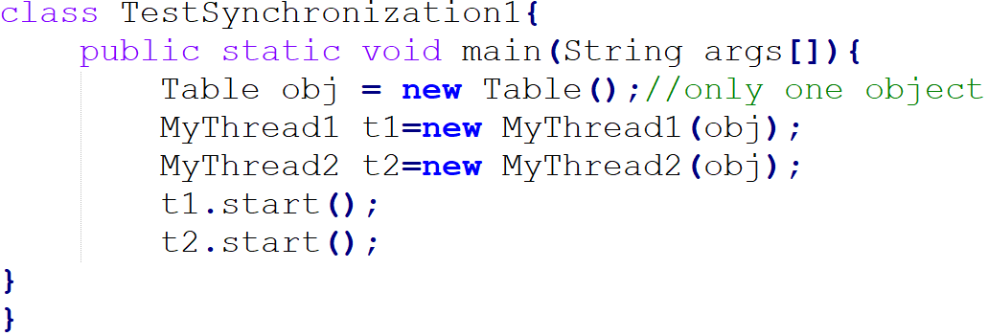
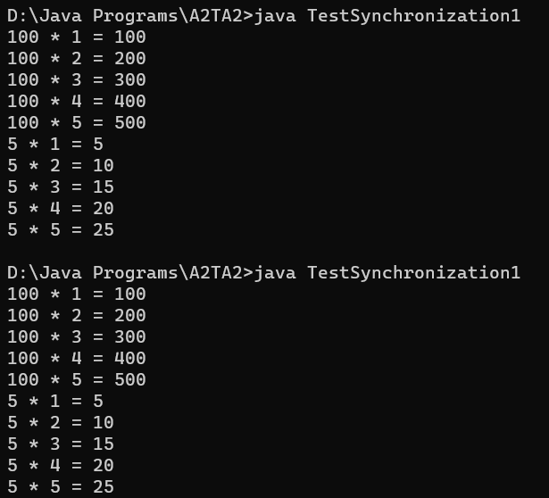
Inter Thread – Non Synchronized (cntd)

Slide 21
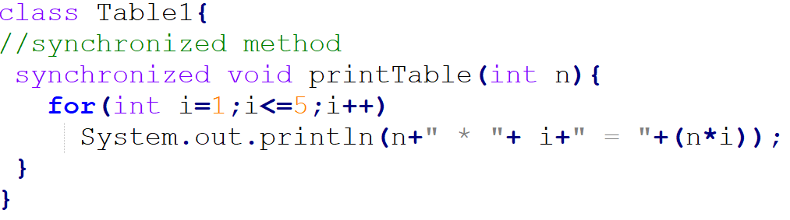
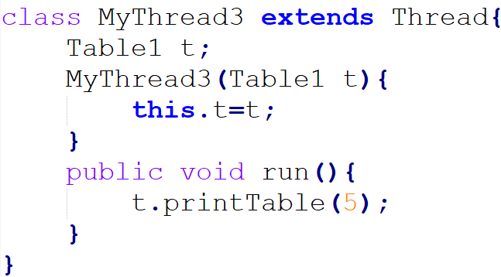
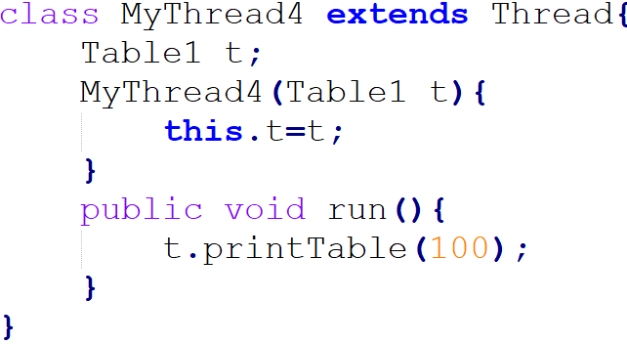
Inter Thread – Synchronized
CALLS TO PRINT 5TH TABLE
CALLS TO PRINT 100TH TABLE

Slide 22
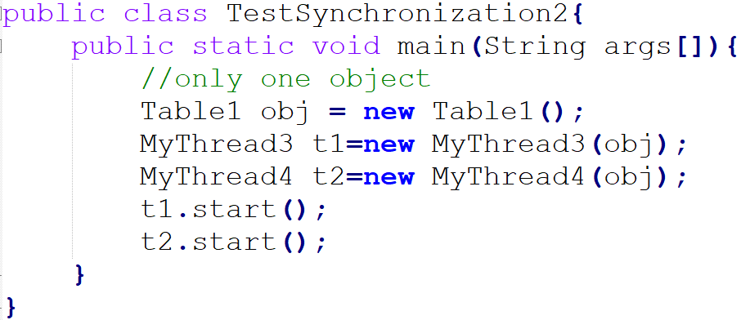
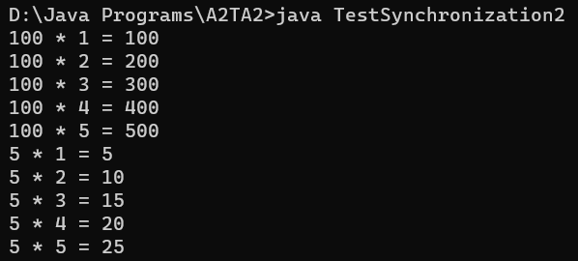
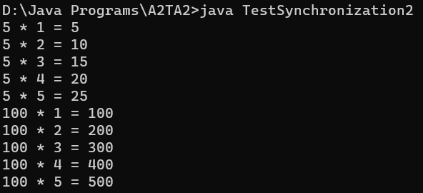
Inter Thread – Synchronized (cntd)

Slide 23
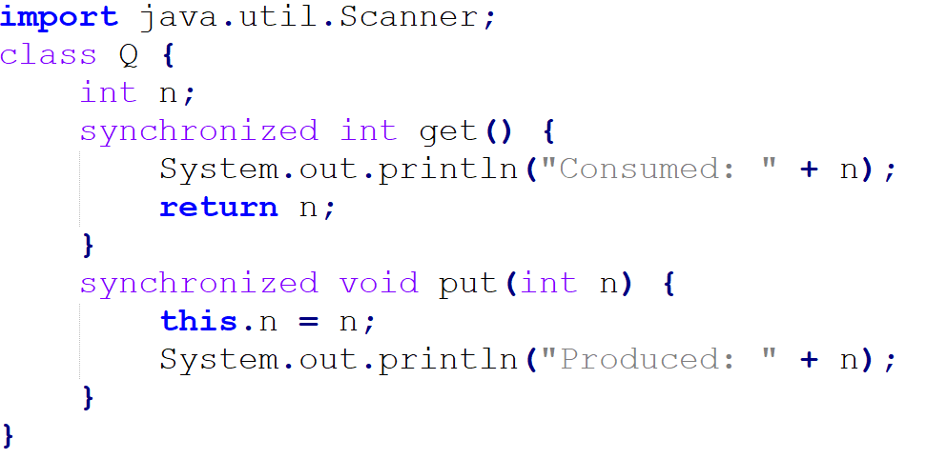
Inter Thread Communications – Non Synchronized

Slide 24
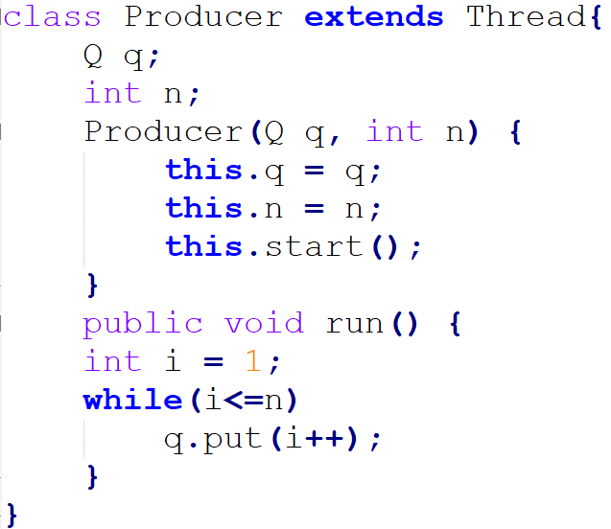
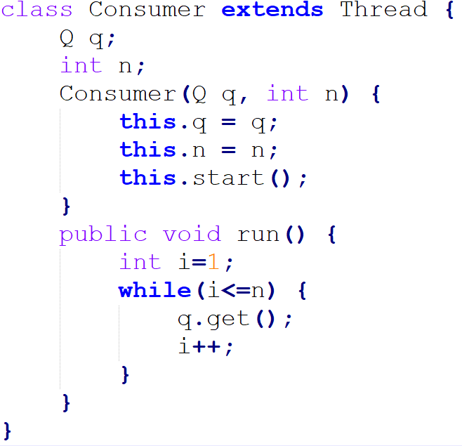
Inter Thread Communications – Non Synchronized

Slide 25
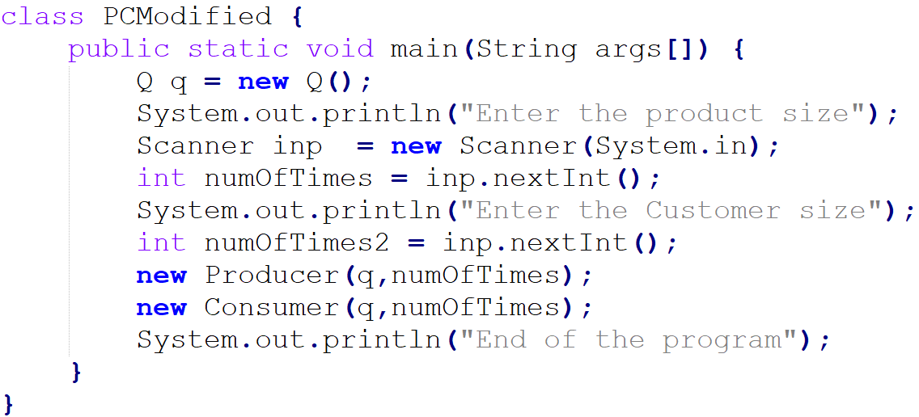
Inter Thread Communications – Non Synchronized

Slide 26
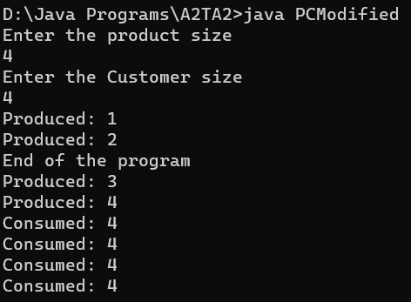
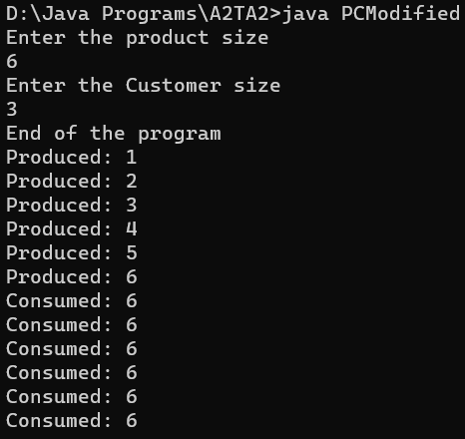
Inter Thread Communications – Non Synchronized

Slide 27
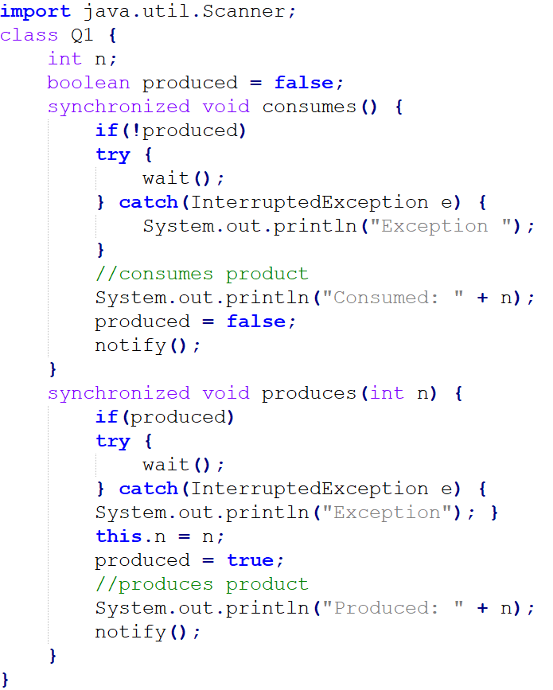
Inter Thread Communications – Synchronized

Slide 28
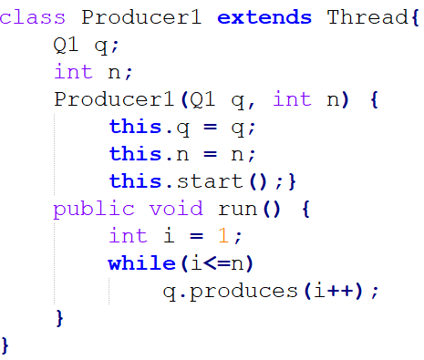
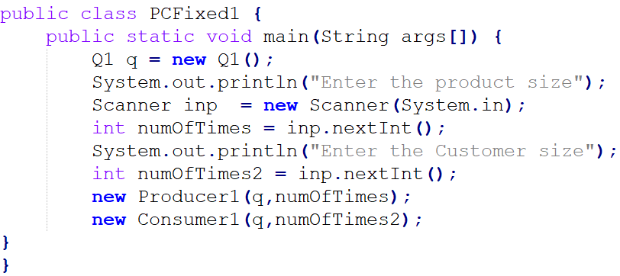
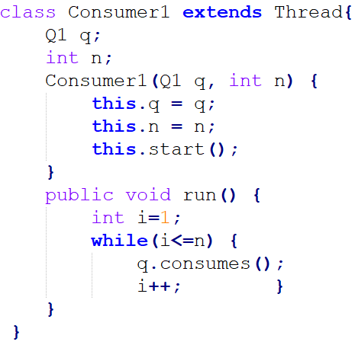
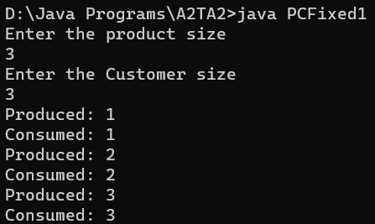
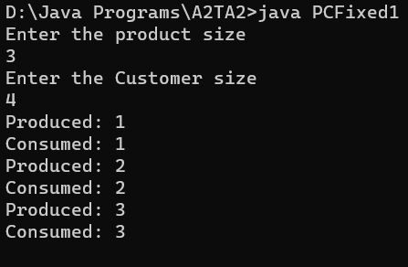
Inter Thread Communications – Synchronized

Slide 29
References
www.javatpoint.com
www.tutorialspoint.com
Herbert Schildt, The Complete Reference -Java, Tata McGraw-Hill Education, Tenth Edition, 2017.
Vijayarani A., AP SITE, VIT, Vellore

